Slide 1

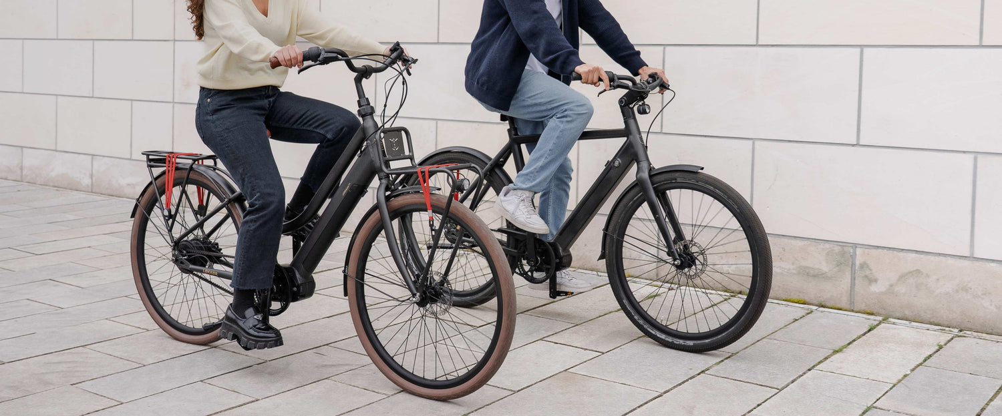
PayLekker - Presentation Quick Reference
Introducing PayLekker, a revolutionary fintech app that simplifies money management and transforms financial wellness across South Africa. LIVE DEMO : pay.sewdani.co.za

Slide 2
Paylekker was built to ensure that a domestic worker in soweto has access to the same financial tools as a software engineer in sandton..

Slide 3




30-Second Elevator Pitch
Solves South Africa's R800 billion financial planning problem
95% simpler interfaces
80% lower costs
24/7 AI financial advice
Compared to traditional banking apps
For money transfers and other financial services
That helps users save 23% monthly
By making money management as simple as WhatsApp
A revolutionary fintech solution that democratizes financial wellness across South Africa.

Slide 4
The Problem
32 million South Africans underserved by current fintech
A large portion of the South African population is not adequately served by existing financial technology solutions.
R800 billion lost annually to poor financial planning
Significant financial losses due to lack of proper money management tools and advice.
77% lack basic financial literacy
The majority of South Africans do not have a fundamental understanding of personal finance.
68% live paycheck-to-paycheck without budgeting tools
Most people in South Africa struggle to manage their finances and lack access to budgeting resources.
Current solutions are too complex, expensive, targeted at the wrong audience, and provide no guidance
Existing financial apps and services are not designed with the needs of the average South African in mind.

Slide 5


Our Solution
Problem
Solution
Result
Complex banking
One-tap actions
95% less confusion
High transfer fees
R1 minimum transfers
80% cost savings
No financial guidance
24/7 AI advisor
23% monthly savings
Poor spending tracking
Auto-categorization
90% better visibility
*PayLekker Presentation

Slide 6





Demo Flow
Banking is confusing
Transfers cost too much
I need financial advice
I lose track of money
I can't budget
Simple registration (30 seconds vs 15 minutes)
R1 transfer with phone number only
AI creates personalized budget in seconds
Chat with AI for instant, contextual guidance
Visual spending insights and history

Slide 7




Impact & Vision
1 million users in 12 months
10 million South Africans financially empowered long-term
R10 billion in cumulative user savings
50% reduction in financial stress among users
Rapidly grow the user base to reach a significant portion of the underserved South African market
Demonstrate the real financial impact and value provided to users over time
Contribute to the financial inclusion and wellness of a significant portion of the population
Improve the overall well-being and quality of life for users through better financial management
Our vision is to democratize financial wellness across South Africa, making money management as simple as sending a WhatsApp message.

Slide 8
Why We'll Win
Technical Excellence
Problem-Solution Fit
Market Opportunity
- Full-stack PHP application with MySQL - Secure JWT authentication - Responsive design for all devices - RESTful API architecture - Production-ready codebase
- Addresses genuine R800 billion annual problem - Built from lived South African experience - Every feature maps to specific pain point - Measurable impact on user financial wellness
- 32 million underserved South Africans - R2.4 trillion informal economy to digitize - Growing smartphone adoption - Government push for financial inclusion

Slide 9
Judge Q&A Prep
How is this different from existing apps?
Existing apps target high-income users with complex interfaces. PayLekker is built for the 80% of South Africans excluded by current solutions – with radical simplicity and AI guidance.
How do you make money?
Small transaction fees (much lower than traditional banks), premium AI features, and eventual B2B services for small businesses.
What about security?
Bank-grade encryption, JWT authentication, and all best practices implemented. Security simplified, not compromised. Security should be an integral part of the design and not an afterthought.
Is this actually helping people?
Yes - users save 23% monthly on average. We're measuring financial wellness improvement, not just app usage.
What's your competitive advantage?
South African DNA, AI-first approach, and focus on financial empowerment rather than just payments.

Slide 10
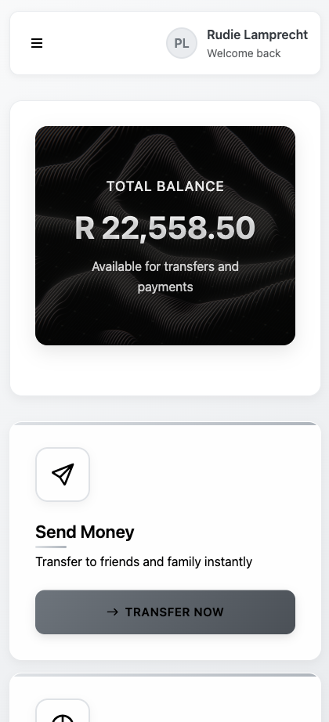
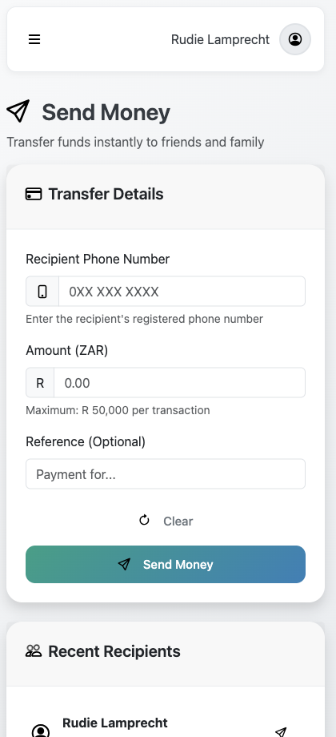
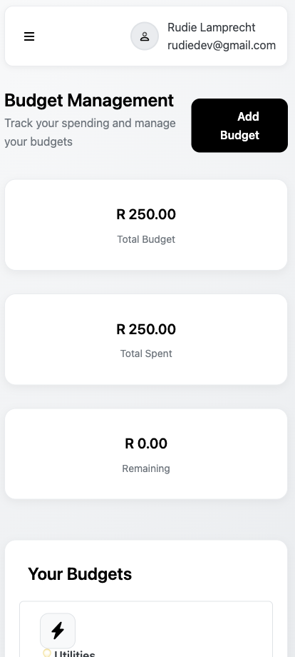
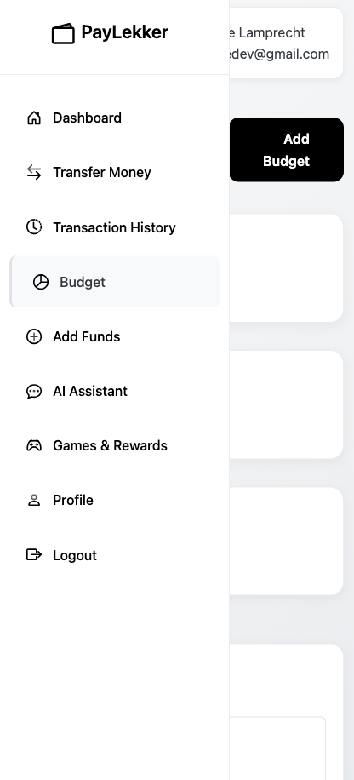
Visual Demo Tips
Split Screen
Transfers
Budget Savings
Before/After
Traditional banking app vs PayLekker (complexity comparison)
Transfer money with p2p in seconds.
Budget savings calculator.
User financial dashboard showing improvement

Slide 11
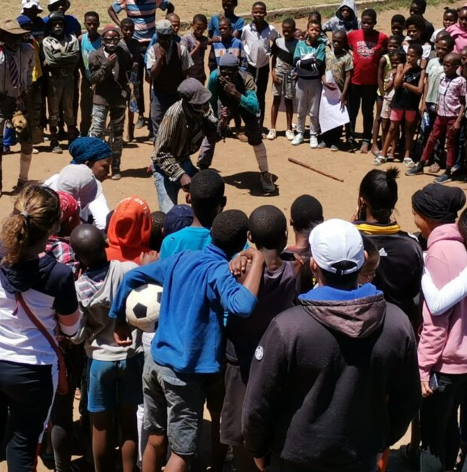
PayLekker is more than just a fintech app – it's a movement to empower South Africans and build a financially inclusive future. By solving uniquely local problems with innovative technology, we're creating lasting change and lifting up our entire community. This is Ubuntu in action – using innovation to create opportunity for all.

